Slide 1



Getting Set Up
Integrated Development Environments
Creative Commons Attribution-NonCommercial-ShareAlike 3.0 Unported License. http://creativecommons.org/licenses/by-nc-sa/3.0/
Written by Rachel J. Morris, last updated 2015-01-14

Slide 2

Integrated Development Environments
We are going to start out by using an IDE to write our C++ code, even though using an IDE isn't required to write a C++ program...

Slide 3
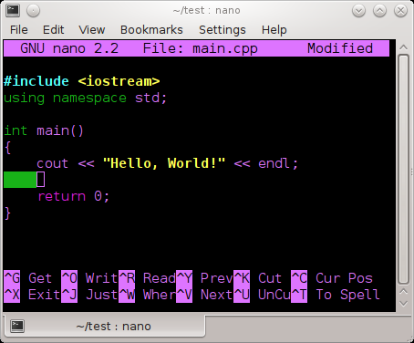
Integrated Development Environments
You could write a program with a normal text editor (think: Notepad, but don't use Notepad – it is terrible.)
and then build your program with a compiler
(this builds it into an executable file.)
A small C++ program written in nano,
A Linux command line text editor.

Slide 4
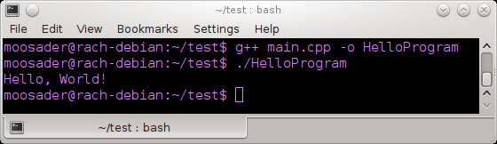
Integrated Development Environments
Building a C++ program from the command line (Linux)
This could be useful if you're on a machine that doesn't have a Graphical User Interface
(But, that's another class!)

Slide 5

Integrated Development Environments
An IDE is an
Integrated Development Environment
Generally, it is a fancy text editor (with syntax highlighting!), debugging tools, and it usually has the build/compile option available from within the program, so you don't have to compile externally.

Slide 6
Integrated Development Environments
IDE != Compiler!
Names of some compilers...
CL (Used in Visual Studio)
gcc, g++ (For Linux)
mingw (Win version of gcc)
Clang
Borland
Note that the IDE is not the compiler!
The compiler is a separate piece, and many IDEs let you use any compiler you want.
Generally, it should not matter* which compiler you use for writing C++ programs – C++ is a standardized language.
* But different compilers may support different features.

Slide 7

So what should
I download?

Slide 8
IDEs for your computer
The school has
Visual Studio
available on its computers, but what if you want to work on your own machine?

Slide 9
IDEs for your computer
Visual Studio Community
https://www.visualstudio.com/en-us/products/visual-studio-express-vs.aspx
Visual Studio Community is the free version of visual studio, meant for “individual developers, open source projects, academic research, education, and small professional teams.”
(So, basically, don't run your gigantic corporation with VS Community)
Only for Windows

Slide 10
IDEs for your computer
Code::Blocks
http://codeblocks.org/
Code::Blocks is an open source IDE, available on multiple platforms. You can use multiple compilers with it.
If you want something more light-weight than Visual Studio, this is what I would recommend!
Note: If you're running it on Windows you should download the version with mingw
(Downloads > Binaries > codeblocks-13.12mingw-setup.exe )
For Windows, Linux, and OSX

Slide 11
IDEs for your computer
XCode
https://developer.apple.com/xcode/
XCode is Apple's IDE for using their languages (Obj-C, Swift),
but also supports languages like C++.
Only for OSX

Slide 12

Got one?
Let's try it out!

Slide 13
How to get started in
Visual Studio
Code::Blocks

Slide 14
Visual Studio

Slide 15
Code::Blocks

